Slide 1
Class 10
BUS 696
Prof. Jonathan Hersh

Slide 2
BUS 696: Class 10 Announcements
Exams
Still grading…
Final Projects
Nov 14th summary stats due
Must summarize training data -> having performed feature transformation and cleaning

Slide 3
BUS 696: Class 10 Outline
HBR AI Articles
Cleaning Factor Levels
Unsupervised Learning
K-means Clustering
Hierarchical Clustering
Principal Component Analysis

Slide 4
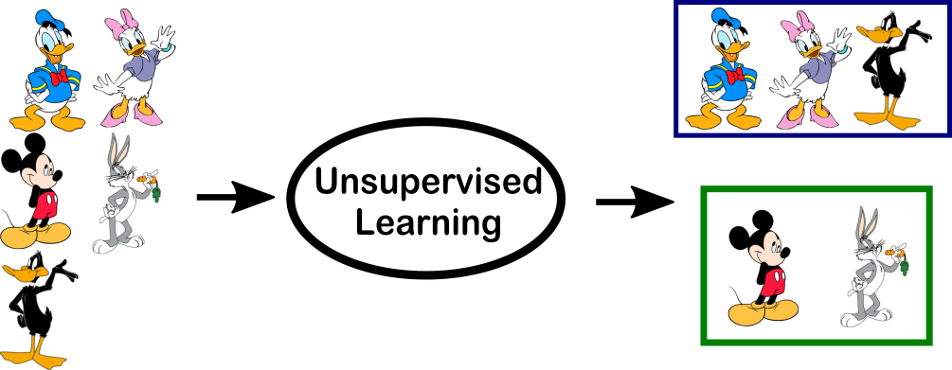
What is unsupervised learning?
All of the machine learning we’ve encountered so far has been supervised learning such as regression
This last lecture will describe unsupervised learning
In unsupervised learning, we observe $x_{1}, x_{2}, x_{p}$, features but we don’t observe any $Ys$

Slide 5

Goals of unsupervised learning
Since we don’t observe $Y′s$, we can’t predict anything
The goal is more subtle here: can we discover interesting patterns in the data? Can we discover useful subgroups?
We’ll discuss two methods
clustering: a broad class of methods for discovering unknown subgroups
principal component analysis: a tool used for data visualization and dimension reduction

Slide 6
Challenge of unsupervised learning
Because we have no “truth”, the end result is more subjective
Some examples of unsupervised learning
subgroup of breast cancer patients that by gene expression are drug resistant
groups of shoppers characterized by browsing and purchase histories
movies grouped by ratings assigned by movie viewers

Slide 7
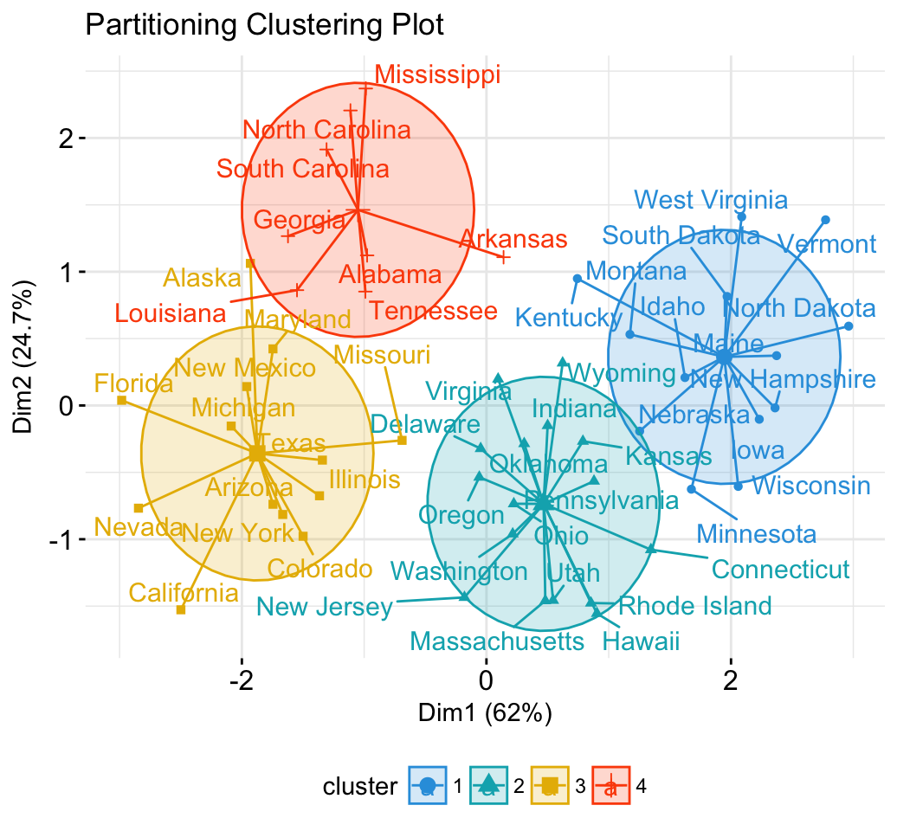
K-means clustering as a “game”
Tell the computer how many groups ($k$) you think the data should be split into
The computer splits the objects into $k$ groups such that the groups are most similar

Slide 8
K-means clustering algorithm
Decide how many clusters we want. Call this K
Randomly assign a number, 1, . . . ,K, to each of the observations. (Initial cluster assignment)
Iterate until clusters stop changing:
Expectation-step: For each of the K clusters, compute the cluster centroid (center point, i.e. means for the k-th cluster)
Maximization-step: Assign each observation to the cluster whose centroid is closest (in Euclidean distance)

Slide 9
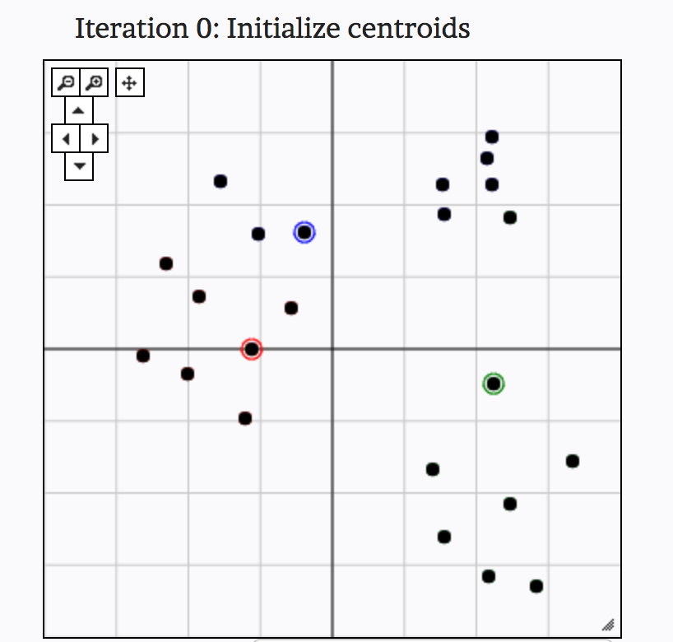
K-means clustering in action
From: http://util.io/k-means

Slide 10
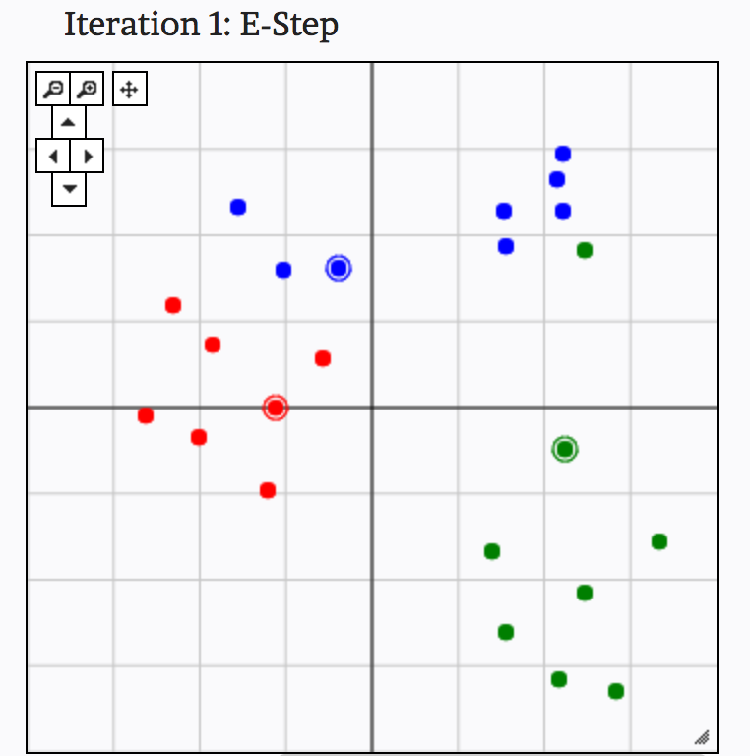
K-means clustering in action
From: http://util.io/k-means

Slide 11
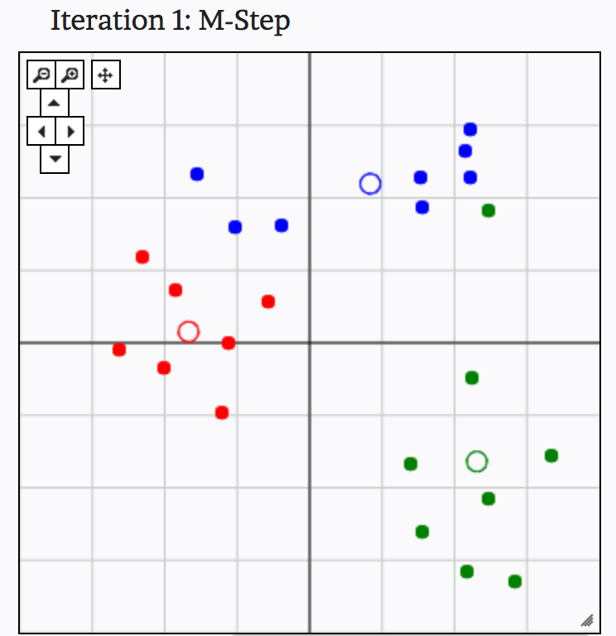
K-means clustering in action
From: http://util.io/k-means

Slide 12
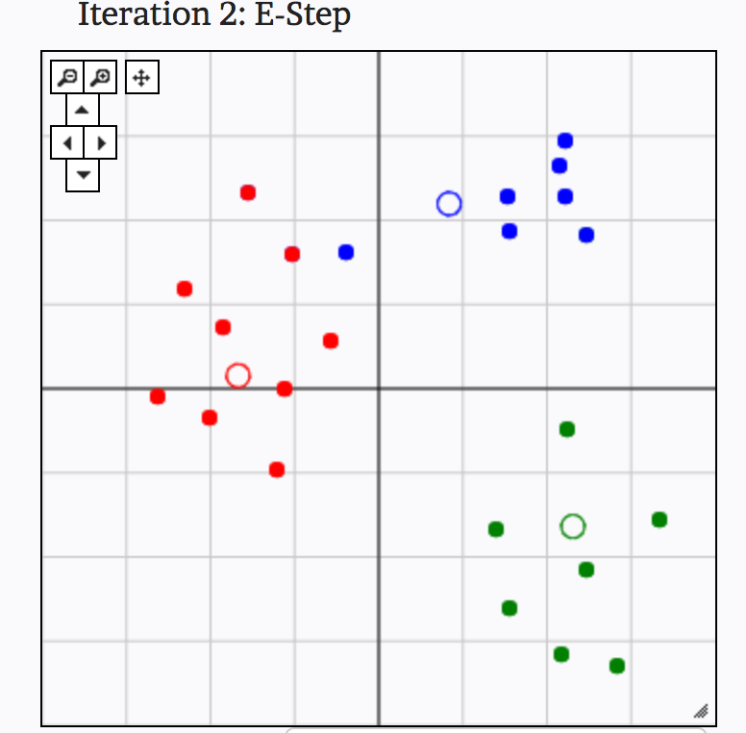
K-means clustering in action
From: http://util.io/k-means

Slide 13
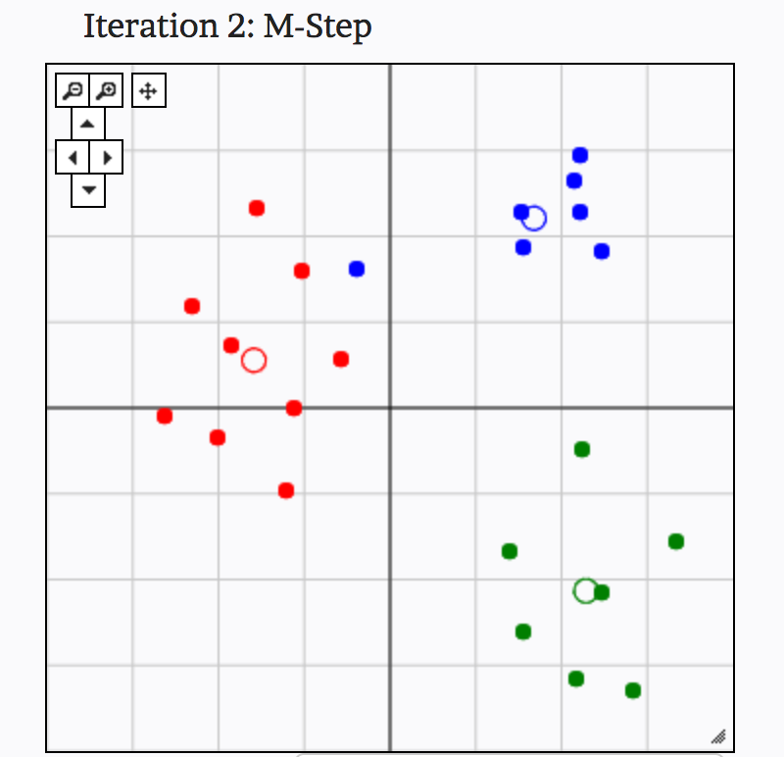
K-means clustering in action
From: http://util.io/k-means

Slide 14
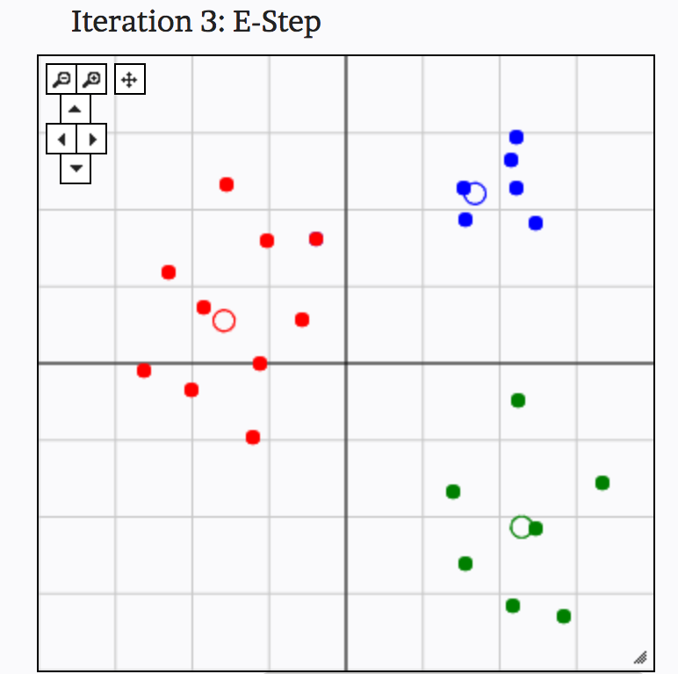
K-means clustering in action
From: http://util.io/k-means

Slide 15
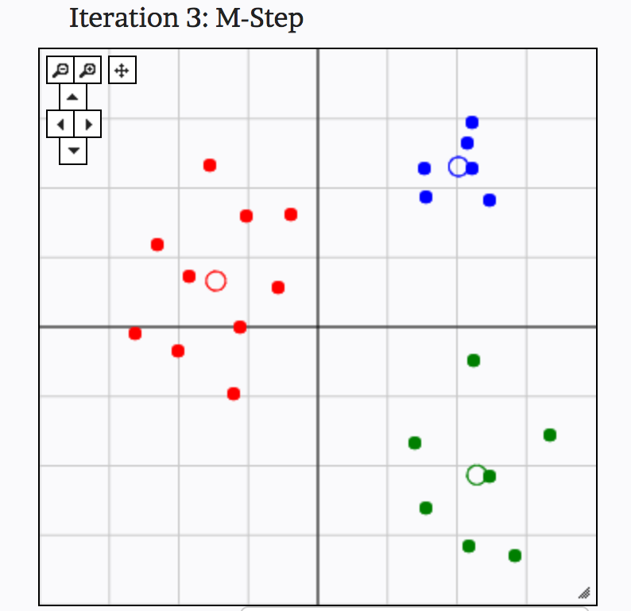
K-means clustering in action
From: http://util.io/k-means

Slide 16
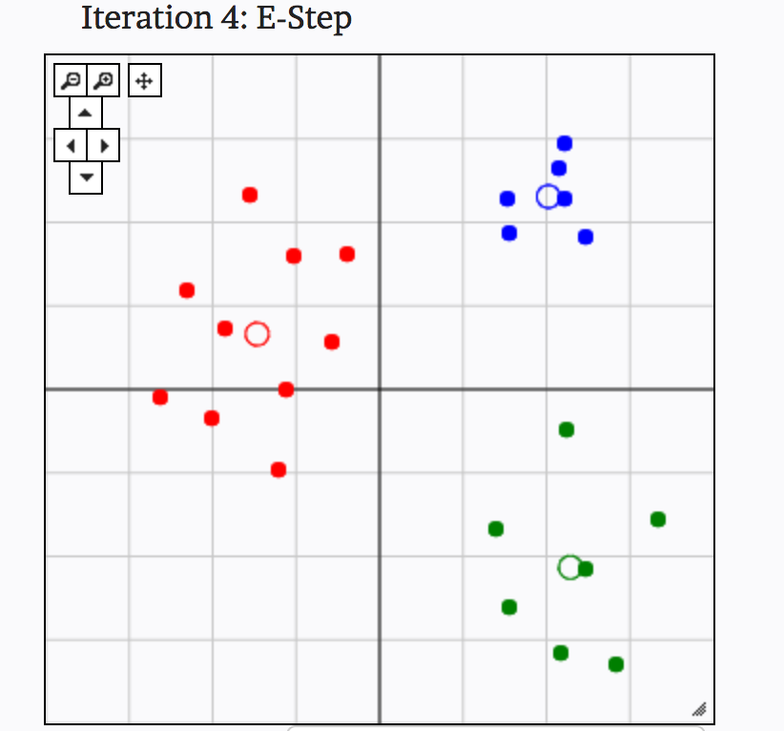
K-means clustering in action
From: http://util.io/k-means

Slide 17
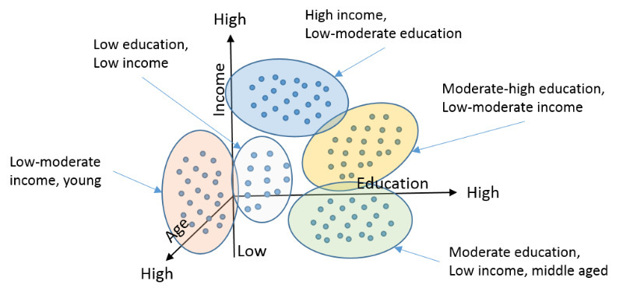
Examples of clustering: Customer Segmentation

Slide 18
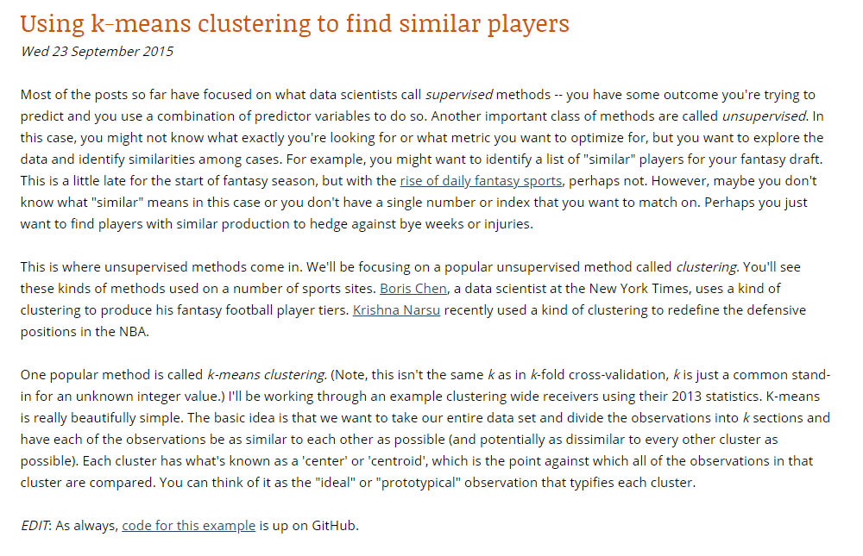
Examples of clustering: Clustering Wide Receivers
From: http://thespread.us/clustering.html

Slide 19
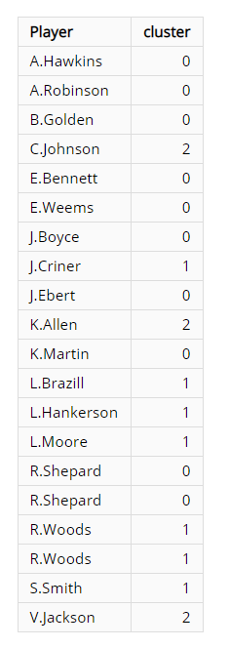
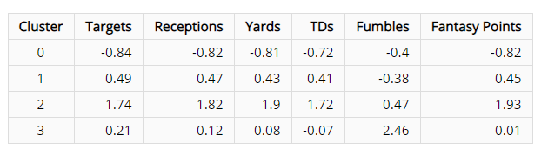
Examples of clustering: Clustering Wide Receivers
From: http://thespread.us/clustering.html

Slide 20
Plan for Today
What topics to cover for Data Management?
Merging data
Dplyr basics
What else?
No problem set 11 (is that okay?)
Signup for presentations
Monday, Dec 3rd
Wednesday, Dec 5th
Hierarchical clustering
K-means code
PCA
PCA code

Slide 21
Hierarchical clustering algorithm
Begin with n observations and calculate all of the pairwise dissimilarities. Treat each observation as its own cluster
For i = n, n − 1, . . . , 2 :
Examine all pairwise inter-cluster dissimilarities among the i clusters and identify the clusters that are most similar. Fuse these two clusters.
Compute the new pairwise inter-cluster dissimilarities among the i − 1 remaining clusters

Slide 22
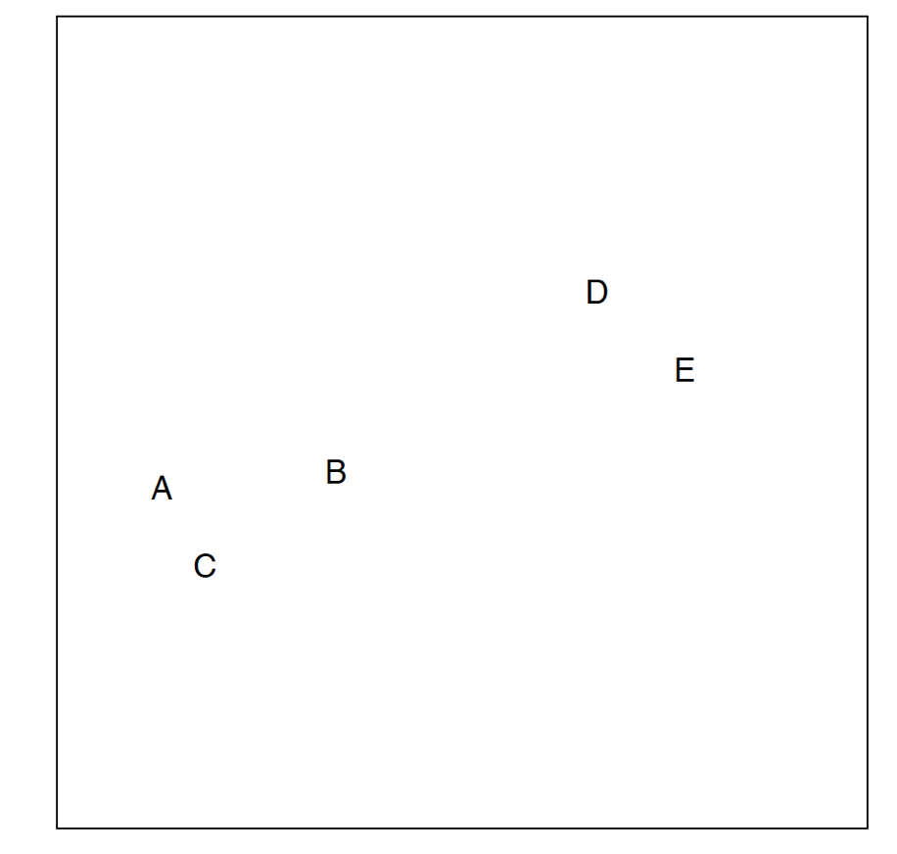
Hierarchical clustering in action

Slide 23
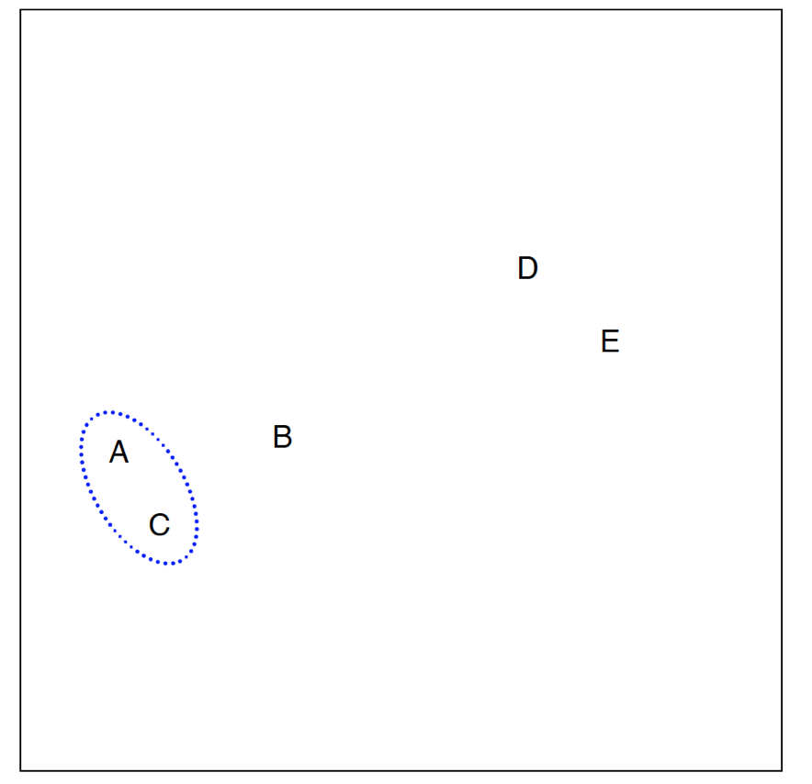
Hierarchical clustering in action

Slide 24
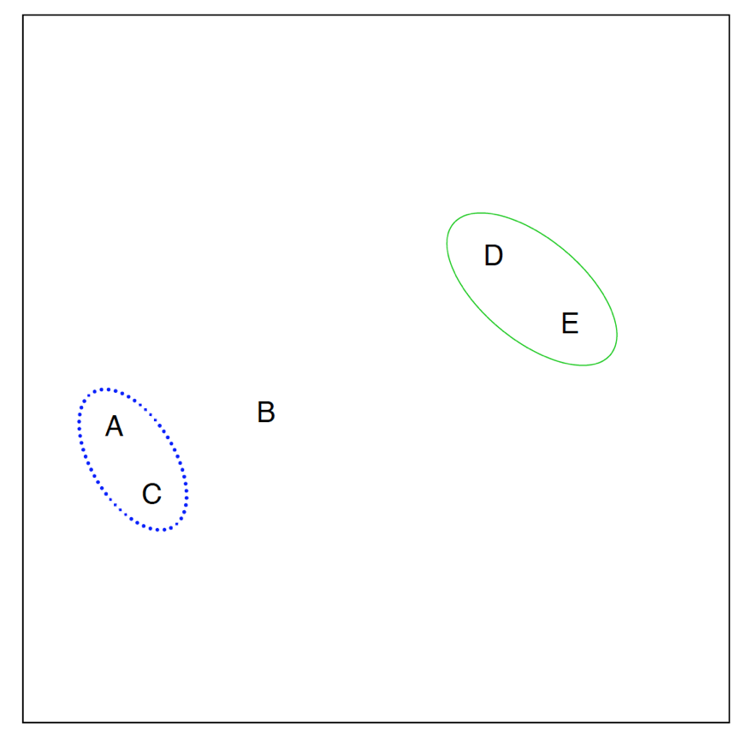
Hierarchical clustering in action

Slide 25
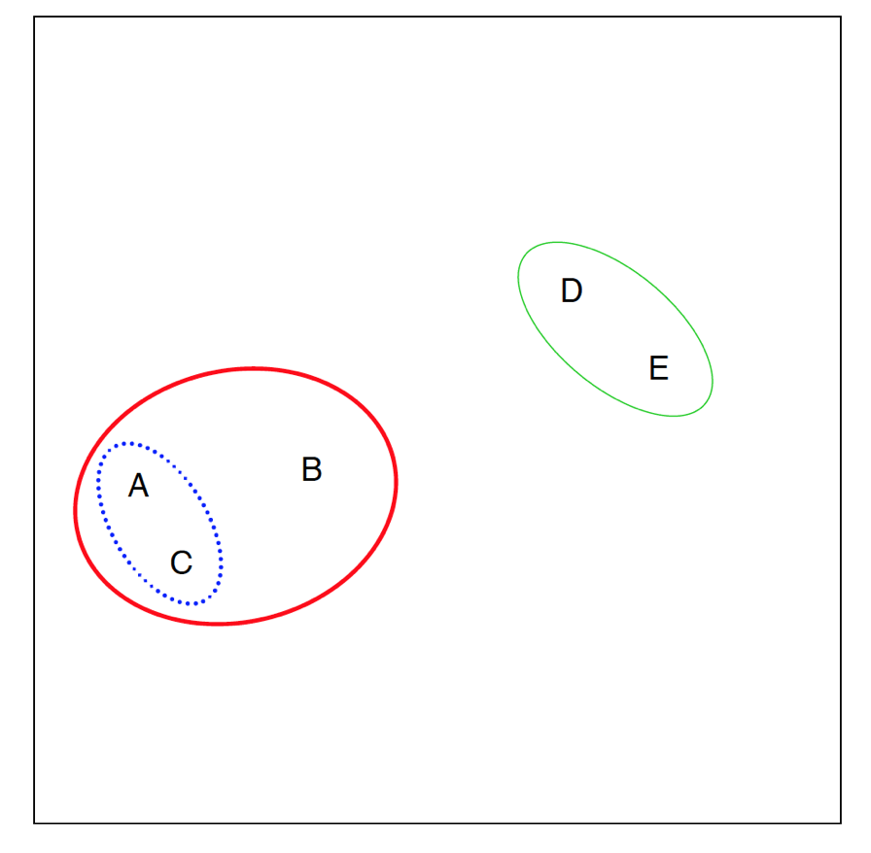
Hierarchical clustering in action

Slide 26
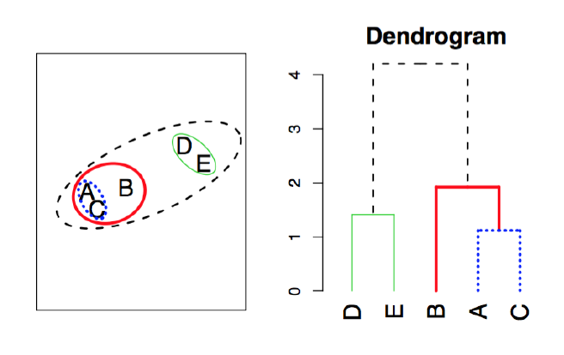
Connection to “dendrograms”

Slide 27
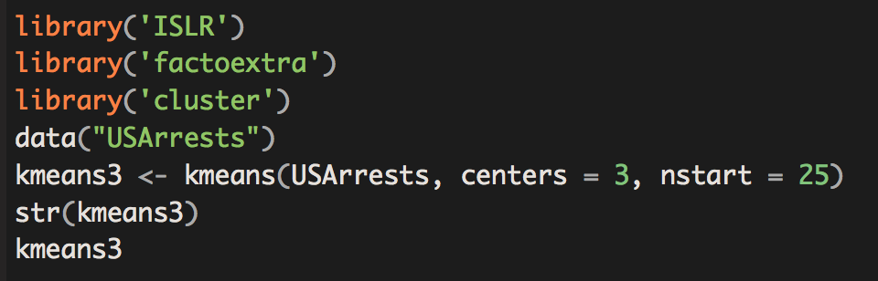
K-means in R

Slide 28
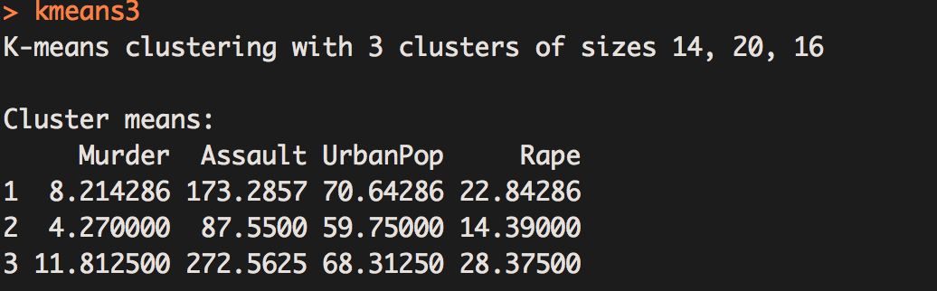
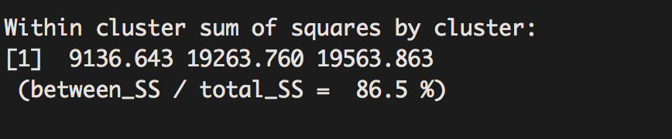
K-means in R

Slide 29
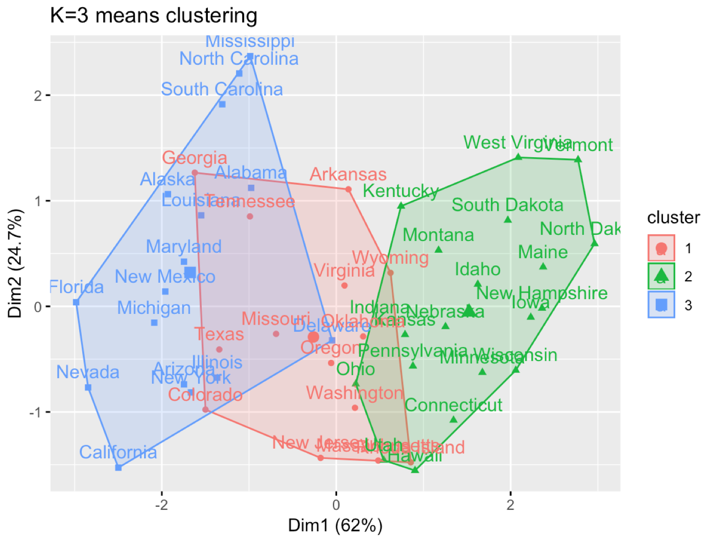

Slide 30
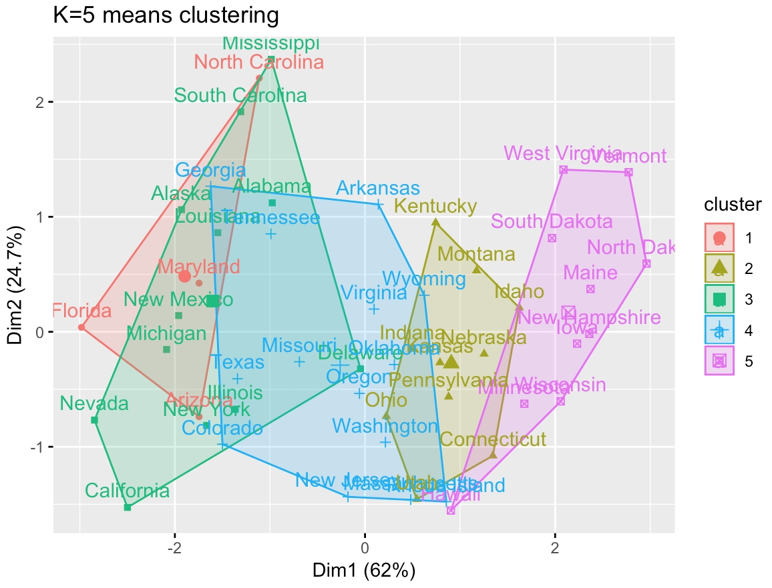

Slide 31
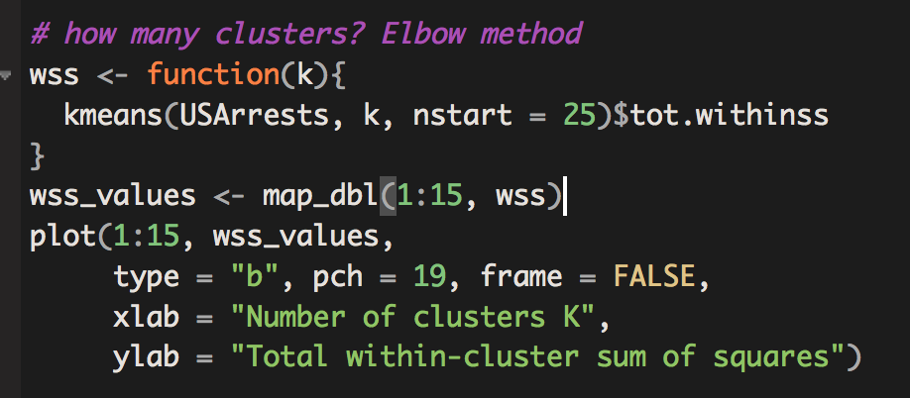
How to pick k? “Elbow Method”
Plot explained variance by # of clusters
Look for the “bend” in the plot

Slide 32
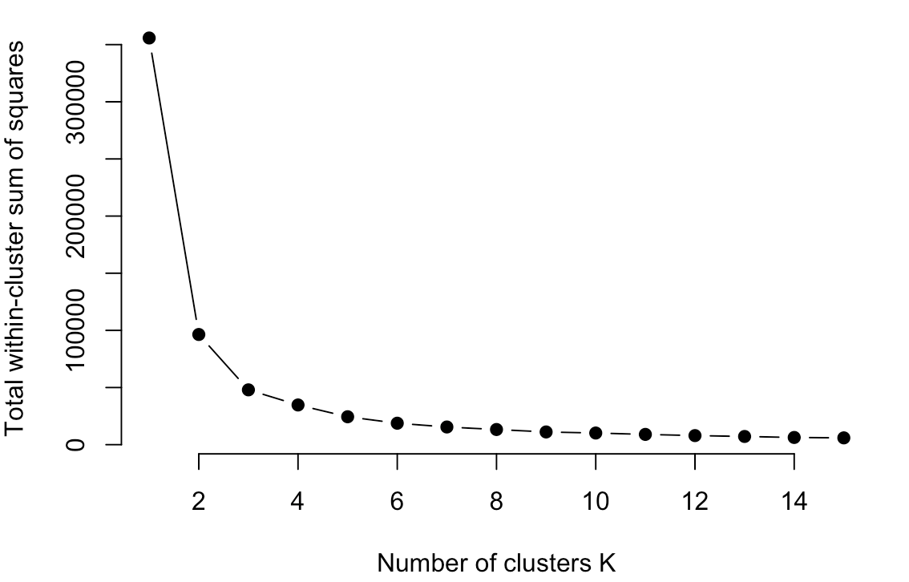
Within-cluster sum of squares by # of clusters

Slide 33
How to pick k?
Silhouette score:
$a_{i}=$ measure of dissimilarity between point i and other observations in its cluster.
1 = good match with cluster
-1 = really bad match
$b_{i}=$ measure of dissimilarity between i and all other points in any cluster
$s_{i}=\frac{b_{i}−a_{i}}{\max\left\{a_{i}, b_{i}\right\}}$

Slide 34
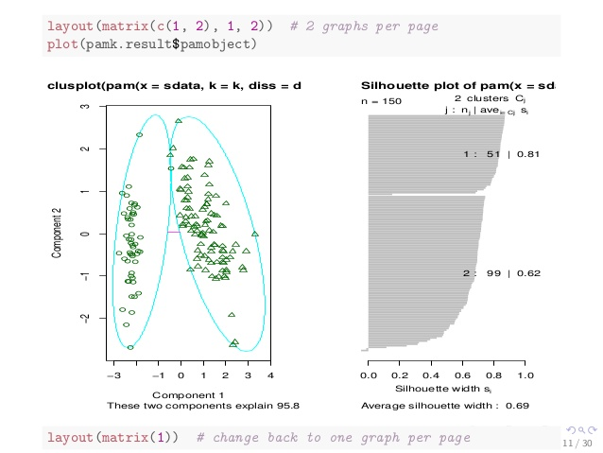
Silhouette Score

Slide 35
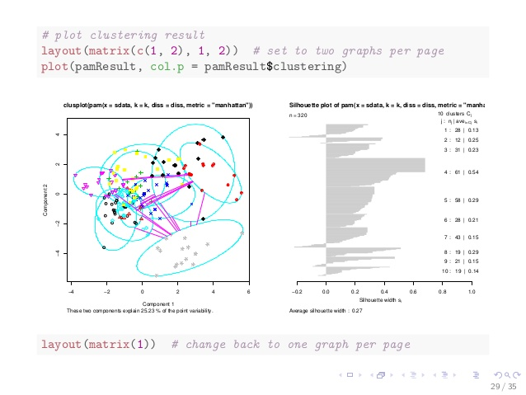
Silhouette Score

Slide 36
Motivation for Dimension Reduction 1
Suppose we want to visualize $n$ observations that have $p$ variables, $X_{1},…,X_{n}$
We could examine every two-dimensional sub-plot
However, that would be $\left(how many\right)$ subplots?
$\left({p \atop 2}\right)=\frac{p(p−1)}{2}$
How do we visualize data to see how “far apart” certain observations are from one another?

Slide 37
Motivation for Dimension Reduction 2
Sometimes in a regression setting, we care about controlling for many characteristics, but don’t care about interpreting those characteristics.
We can take those control variables, project them down into a lower dimensional subspace, then control for only those lower dimensional variables
E.g. take 100 controls variables, project down to 2 dimensions, and only control for those 2 variables

Slide 38
Enter Principal Component Analysis
PCA produces a low-dimensional representation of a dataset.
It does so by finding directions of maximal variance that are mutually orthogonal
In other words it asks the question
If I had to pick a set of direction such that if I projected the data onto those directions, and then computed the variance of the points, which directions would maximize explained variance?

Slide 39
First Principal Component
PCA finds sequence of linear combinations of the variables that maximize variance and are mutually uncorrelated
The first principal component of a set of features $X_{1},X_{2},…,X_{p}$ is the normalized linear combination of the features
$$Z_{1}=φ_{11}X_{1}+φ_{21}X_{2}+…+φ_{p1}X_{p}$$
That have the largest variance
Normalized here means $\sum_{j=1}^{p}{φ_{j1}^{2}}=1$
$φ_{1}={\left(φ_{11}φ_{21}…φ_{p1}\right)}^{T}$ is the vector of factor loadings of the first principal component

Slide 40
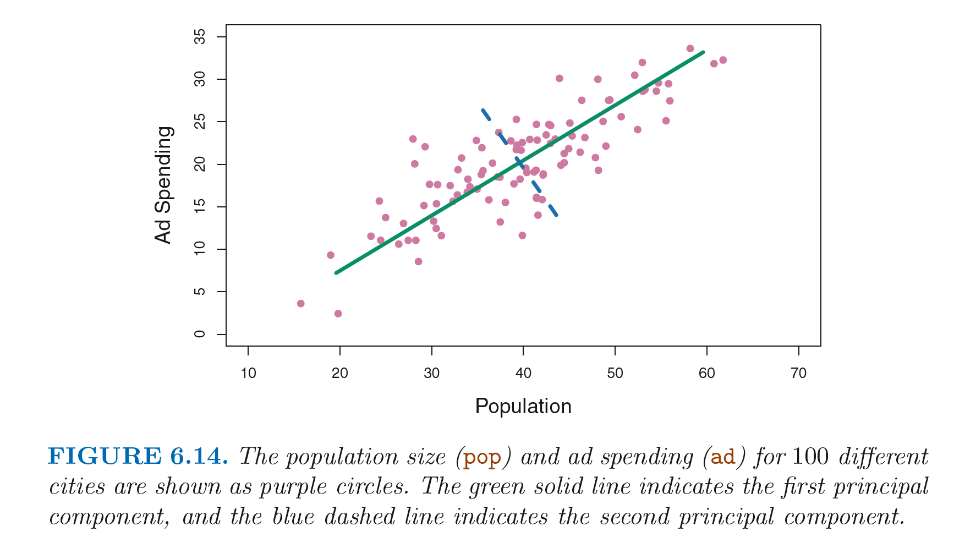
First Principal Component

Slide 41
Second Principal Component
After we have calculated the first principal component,$Z_{1}$, the second principle component is the linear combination of $X_{1},⋯,X_{p}$ that has maximal variance out of all linear combinations that are uncorrelated with $Z_{1}$
The second principal component takes the form
$Z_{2}=φ_{12}X_{1}+φ_{22}X_{2}+…+φ_{p2}X_{p}$
$φ_{2}={\left(φ_{12}φ_{22}…φ_{p2}\right)}^{T}$ is the vector of factor loadings of the second principal component
Constraining $Z_{2}$ to be uncorrelated with $Z_{1}$ is equivalent to constraining $X_{1}$ to be orthogonal (perpendicular) to $X_{2}$

Slide 42
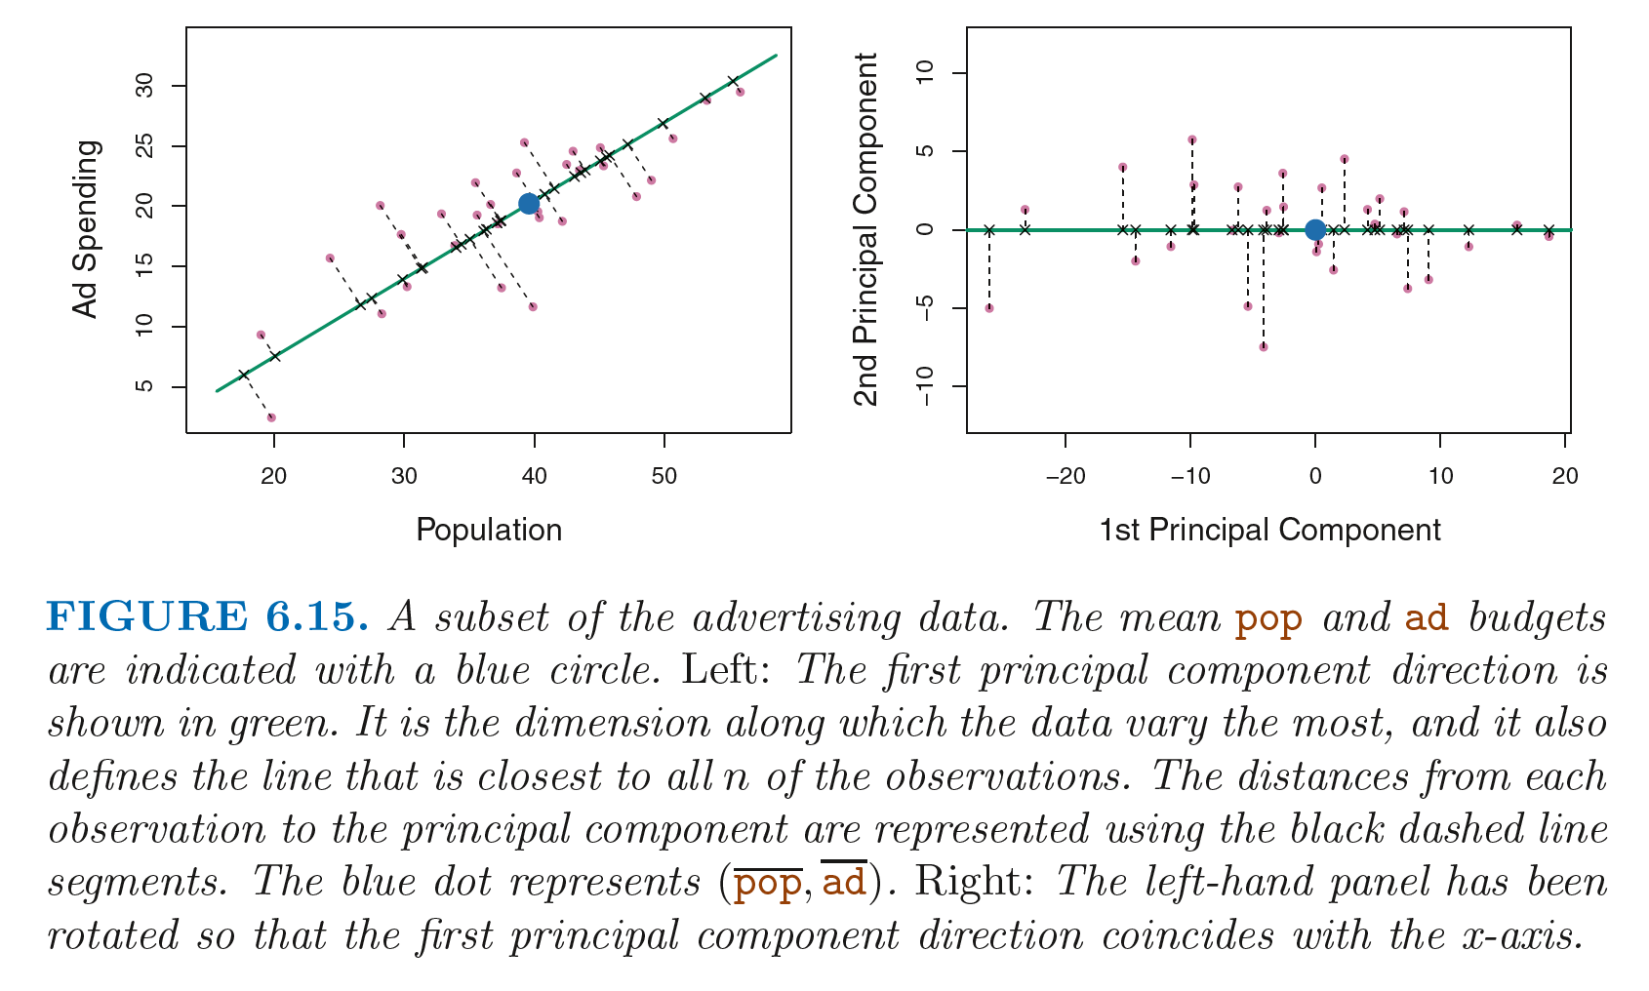
Second Principal Component

Slide 43
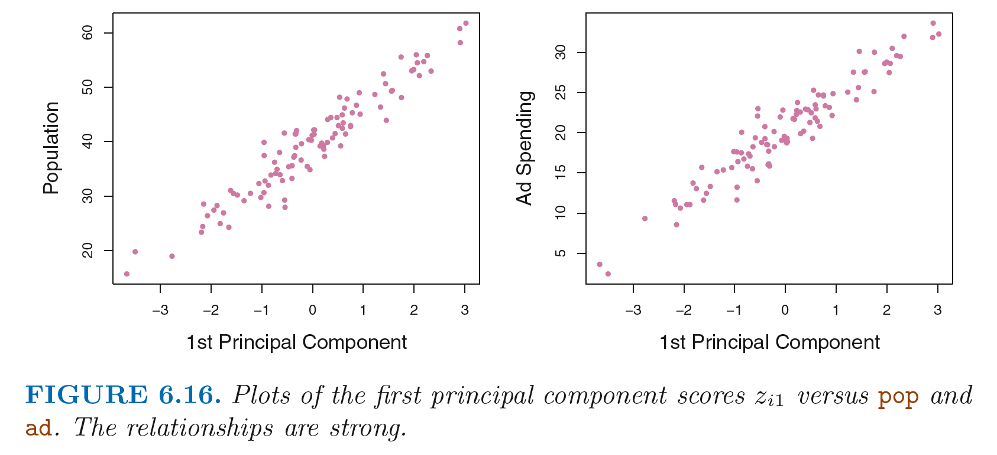
Second Principal Component

Slide 44
PCA Illustration
USAarrests data: For each 50 state in the US, number of arrests per 100,000 residents for each of the three crimes: assault, murder, and rape. Also record UrbanPop.
Principal component score vectors have a length of n = 50, and loading vectors have length p = 4
PCA was performed after standardizing variables to have a mean of 0 and standard deviation of 1.

Slide 45
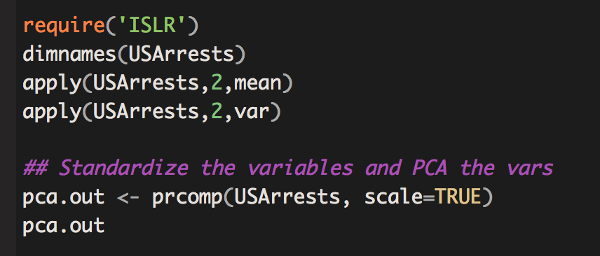
PCA Illustration

Slide 46
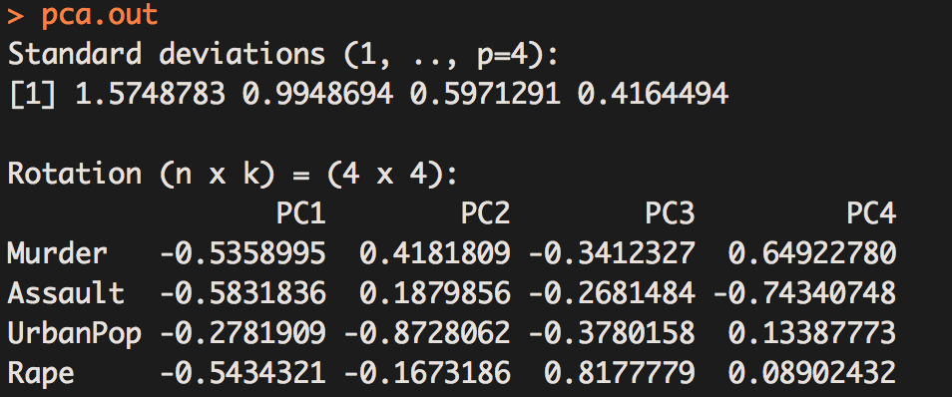
PCA Illustration
Factor
loadings

Slide 47
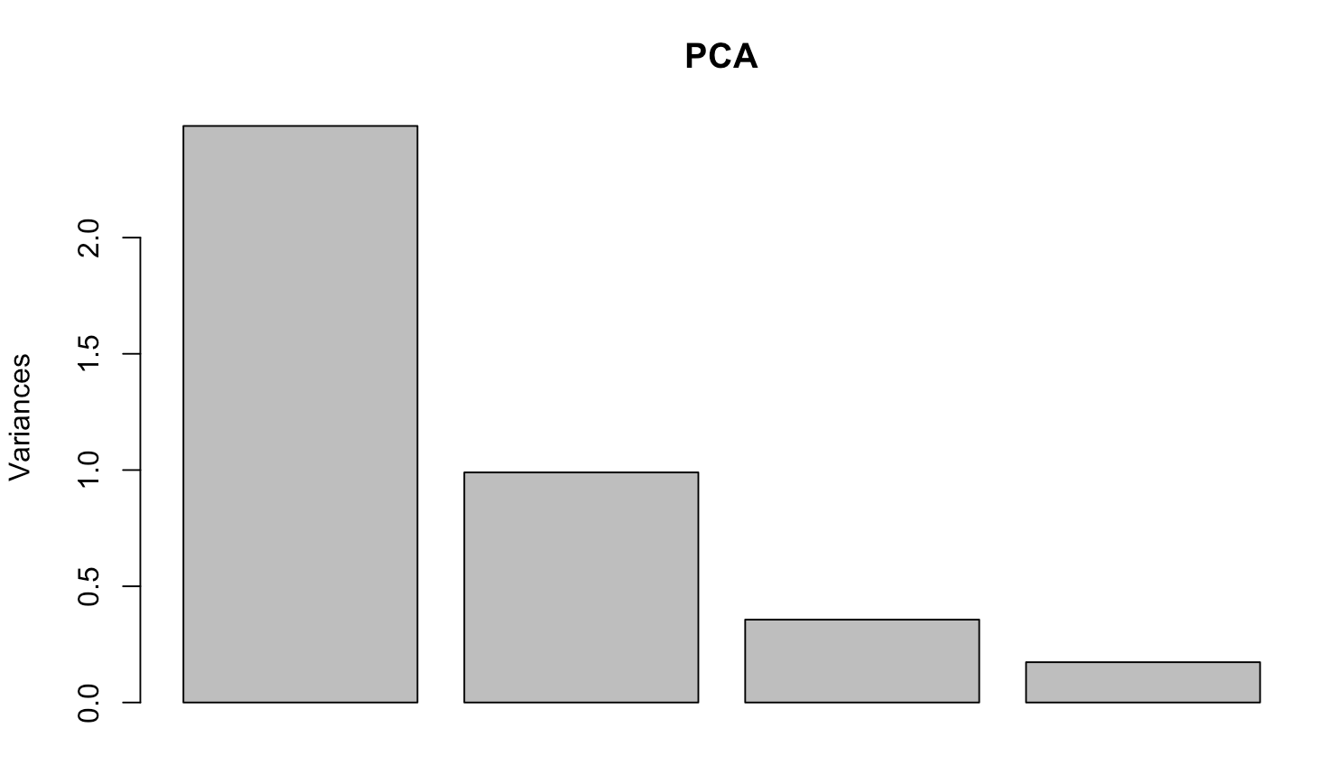
How many PCAs to use? “Elbow Method” from “Skree” plot

Slide 48
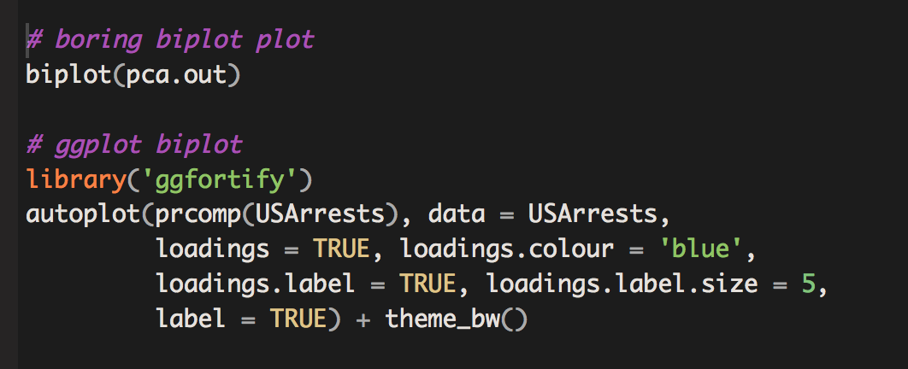
Plotting PC1 and PC2
As promised, we can now use the 1st and 2nd principal component to visualize the P-dimensional data on a 2-dimensional plot
This is called “projecting” our data in 2 dimensions

Slide 49
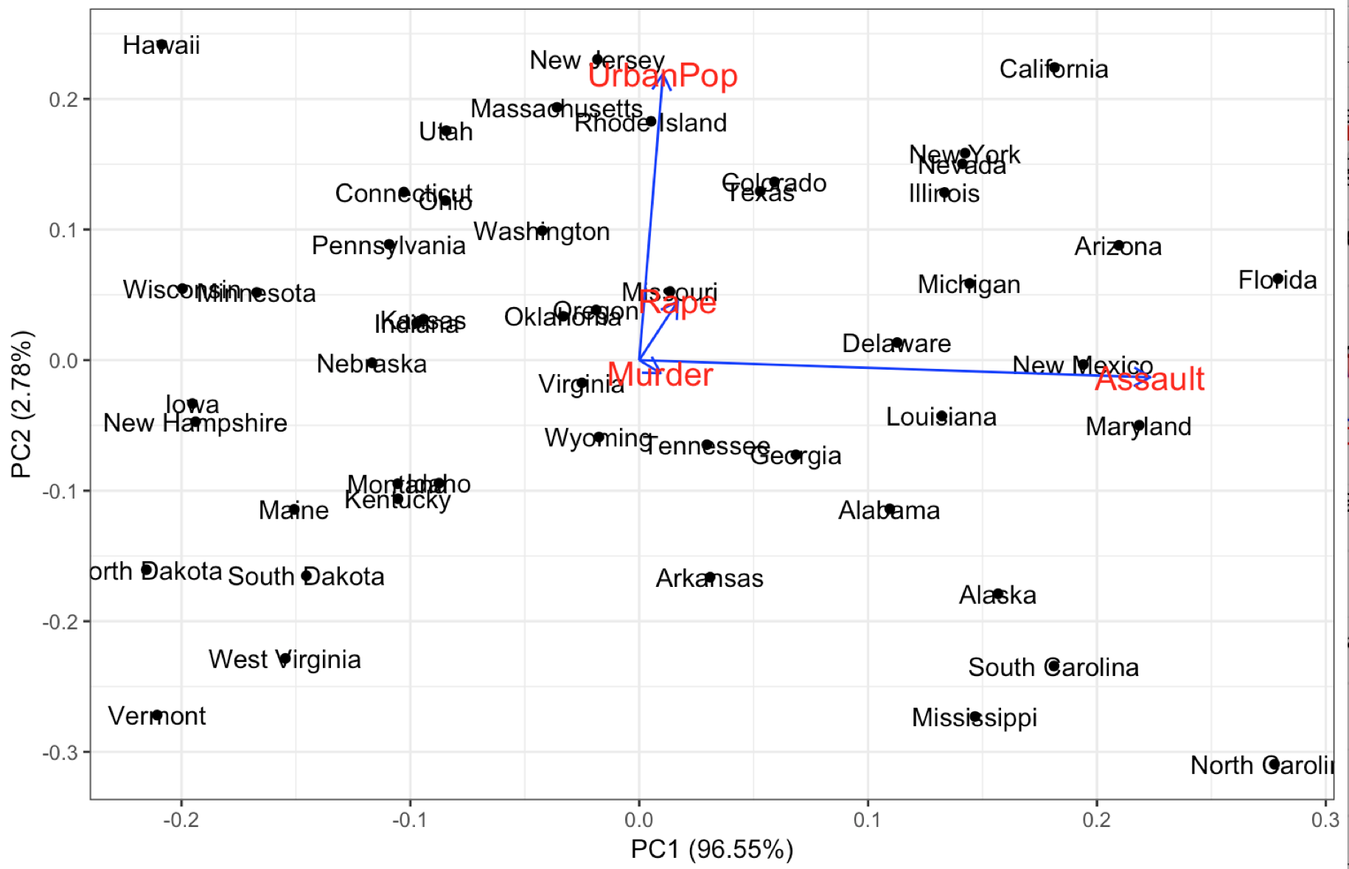
PCA “Biplot”

